Slide 1
Advanced Data Analytics – Web Scraping
Presented by
Jesina Banu J

Slide 2

Agenda
What is web scraping?
Why web scraping is used?
Why Python is used for Scraping?
Software Requirements
Libraries used for Web Scraping
My experiment with web scraping
Process of Data Analysis
Advantages & Disadvantages
Conclusion
GitHub Link

Slide 3
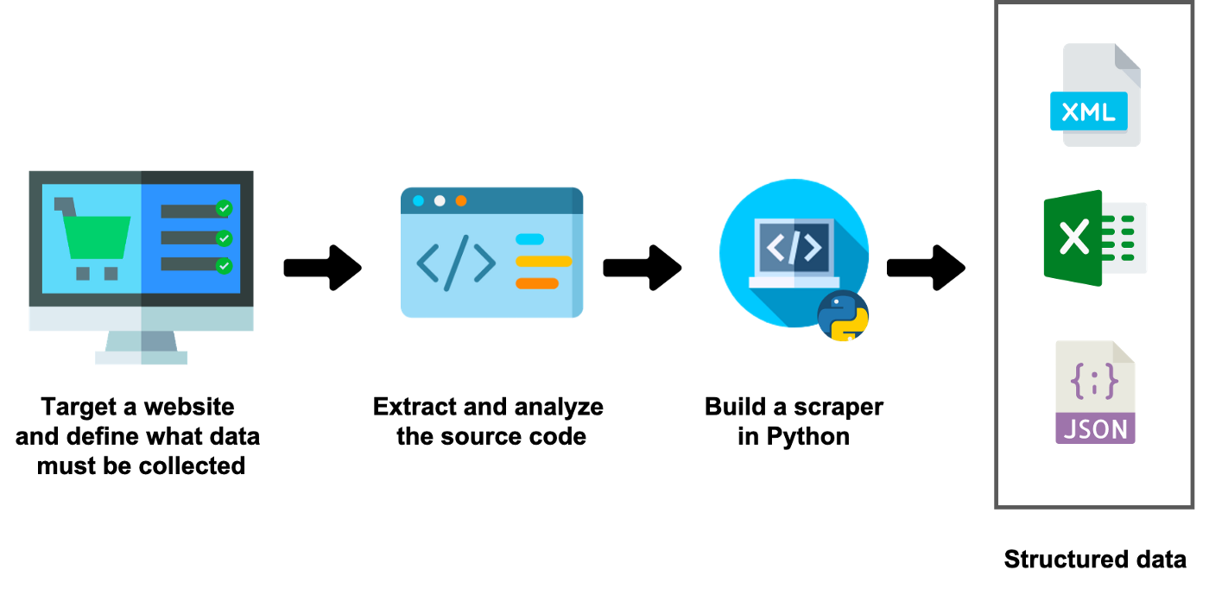
What is web scraping?
To extract a large amount of data from several websites.
It helps to collect those unstructured data and convert it in a structured form.

Slide 4
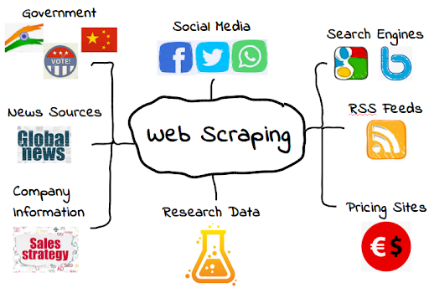
Why web scraping is used?
Price Comparison
Extract offers & Discounts
Email address gathering
Social Media Scraping
To make a search engine
Research and Development
Job listings
News & Content Monitoring

Slide 5

Why Python is Used for Scraping?
Ease of Use
Large Collection of Libraries
Dynamically typed
Easily Understandable Syntax
Less code & Large Task
Open-Source Community

Slide 6
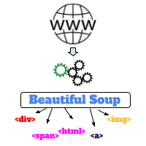
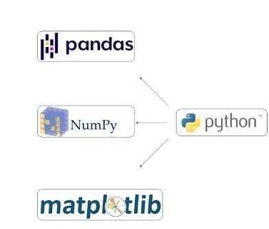
Software Requirements
Jupyter Notebook
Libraries Used
BeautifulSoup
Urllib
Pandas
Numpy
Matplotlib
Seaborn

Slide 7
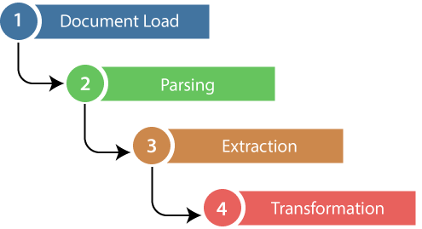
How to Scrape Data From A Website?
Fetching the Data
Step 1 - Find the URL
Step 2 - Sending HTTP requests to the server
Step 3 - Parse the Html document
Web Scraping Example : Scraping Flipkart Website
link="https://www.flipkart.com/search?q..."
pagecontent=u(link)
pagecode=pagecontent.read()
pagecode

Slide 8
Extracting the desired data
Step 4 - Inspect the page
Step 5 - Find the data you want to extract
Step 6 - Write the code
Step 7 - Run the code and extract the data
Finding all the product names
productname_1=[]
modelname=page_file.findAll("div",{"class":'_4rR01T'})
for i in modelname:
p=i.text
productname_1.append(p)
Productname_1
Likewise, the above same code is used to find the Price and Discounts of the Products.

Slide 9
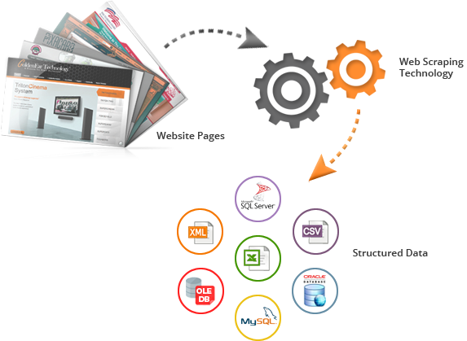
Export the Data
Step 8 – Store the results in either database, csv, excel, text file etc.
Creating Data Frame and then Storing the extracted data in csv format
d1={'productname_1':productname_1,'PRICE_1':PRICE_1,'PRICE_2':PRICE_2,'Discount_1':DisPrice_1}
df1=pd.DataFrame(d1)
df1.to_excel("flipkartdata.xlsx")
df1=pd.read_csv('flipkartdata.csv')
df1

Slide 10
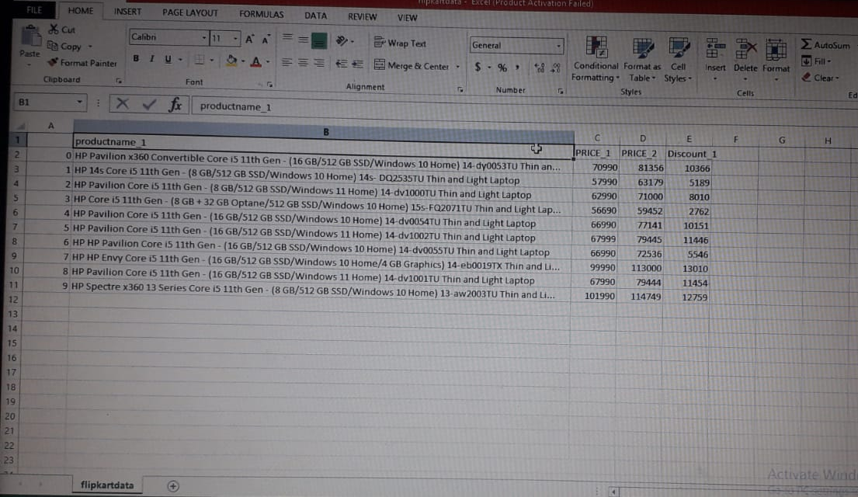
Output : Csv file

Slide 11

Process of Data Analysis
Data Collection using Web Scraping
Data Transformation
Data Cleaning
Data Wrangling
Error Analysis
Inferential Statistics
Data Visualization
And also, did a product comparison between two different websites.

Slide 12
Advantages
No rate limiting
Anonymous access
Interfacing with 3rd party with no API’s
Cost Effective
Easy to implement
Low maintenance and speed
Disadvantages
Protection policies
Conclusion
It has a drastic and great effect on organizations who want data. Web Scraping is a completely legal process.
Scrap wisely & Do not steal

Slide 13

GitHub
https://github.com/Jesina/Advanced-Data-Analytics---Web-Scraping

